Slide 1
restart logic
An Overview

Slide 2
Basics of Databases
Concurrency - Database is consistent when multiple users access it at the same time
Recovery - Database is brought back to a consistent state in case of failures
Integrity - Application data constraints

Slide 3
LUW
LUW is the span of time during which database updates must be performed. Either they are all performed or all thrown away.
An LUW begins
When transaction starts
When database changes of previous LUW is commited
When database changes of previous LUW is rolledback

Slide 4
Issues without Restart logic
Assume a large batch job that process millions of records is coded without restart logic has abended.
All database updates will be rolled back and the job should be submitted from the beginning.
Maintain large number of locks for a long period reducing concurrency
The program may abend if it acquires more than the installation-defined maximum number of locks
Restoration procedure take more time

Slide 5
Checkpoint
Establishes a place in the program from where the program can be restarted.
Releases locked resources
Changes are applied to the physical database
When the program terminates normally, checkpoint is triggered

Slide 6
Checkpoint Example
Rec1
Rec2
Rec3
Rec4
Rec5
------------Checkpoint if frequency is 5
Rec6
Rec7
Rec8
Rec9
Rec10
------------ Last Checkpoint

Slide 7
Types of checkpoint
Basic Checkpoint
- Stores only Checkpoint ID
- Does not support GSAM files
- Used by MPPs and online programs
Symbolic Checkpoint
- Stores Checkpoint ID and critical information
- Supports GSAM files
- BMP and batch programs

Slide 8
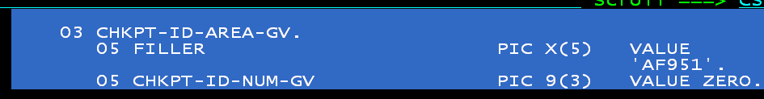
Checkpoint ID
8 bytes long
Identifies a record that is written to the log file

Slide 9
Things to do in Working Storage
Here the variables required to restart the program need to be saved.

Slide 10
Things to do in Procedure Division
If it is a normal start, RESTART-ID-AREA-GV will be empty, else it will hold the value of checkpoint ID

Slide 11
XRST Call
Must be issued only once
Should be issued early in the program
Must precede any CHKP call
Any database calls issued before the XRST call are not within the scope of a restart.
When program is started normally, the I/O area in XRST call must contain blanks and the CKPTID= value in the PARM field must be nulls.
When program is restarted, checkpoint ID should be entered in the I\O area or by specifying ID in JCL

Slide 12
Checkpoint Frequency
Indicates a commit point in IMS programs
Use a counter to keep track one of the following.
- Elapsed Time
- Number of root segments accessed
- Number of updates performed.

Slide 13
Checkpoint in NAB
CHKPFREQ is the logical DD

Slide 14
Checkpoint Logic Example
Input File Output File
Rec1 Success rep:
Rec2 Rec1
Rec3 Rec2
Rec4 Rec3
Rec5 Rec5
----------AF001 Rec6
Rec6
Rec7 Error Rep:
Rec8 Rec7
Rec9
Rec10
----------AF002

Slide 15
GSAM databases
Generalised Sequential Access method
Batch processing access method that allows sequential files to be treated as IMS databases
It has no segments , key or parentage

Slide 16
Accessing GSAM
Cannot delete or replace records
Reads records sequentially using GN call
Add records using ISRT call
When IMS restores the data areas specified in the XRST call, it also repositions any GSAM databases that your program was using when it issued the symbolic CHKP call

Slide 17
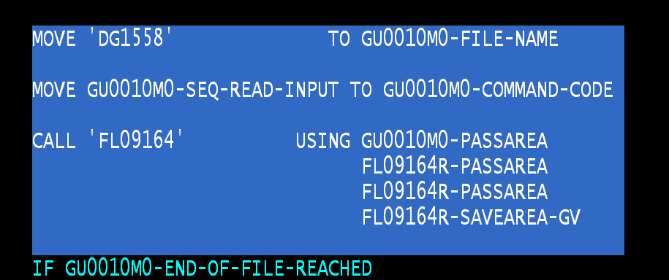
Accessing GSAM in NAB

Slide 18
Checkpoint parameters
1-8 character extended checkpoint ID
14- character “Time stamp” ID IIIIIDDDHHMMSST from message DFS0540I in the joblog
IIIII is the region ID
DDD is the day of the year
HHMMSST is the time in hours , Minutes , seconds and tenth of a second
4-character constant “LAST”

Slide 19
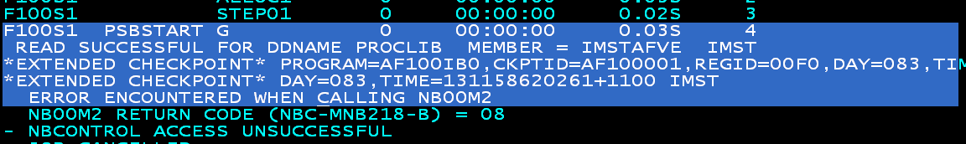
Checkpoint

Slide 20
IEFRDER and IMSLOGR
All information saved during the issue of checkpoint and abend information are written in to the log dataset IEFRDER
The LOG dataset IMSLOGR is used for reading the abend information at the time of restart.
IEFRDER log dataset of the abended job should be given as IMSLOGR dataset of the restart job.
Notes:
SELECT *
FROM PD.MP_BRAND PD2
WHERE PD2.MP_ID NOT IN
(SELECT DISTINCT MP_ID
FROM PD.MRKT_PCK_AVAIL)
We do have some MP_ID that is not part of any MU ID but still available under brand. Above query can be used to retrieve them

Slide 21
Points to be remembered
Use original job name when restarting as IMS cannot locate checkpoint and fails with U0102(Restart information not available)
At completion of the XRST call, IO area always contains 8 character checkpoint ID
Always issue checkpoint after a unit of work is completed. If we issue a checkpoint soon after we read a record , then all information of that record needs to be saved.
If the program is restarted and the checkpoint log records no longer reside on the Online Log dataset(OLDS) or System Log Dataset(SLDS), IMSLOGR DD defining the log dataset must be supplied
Notes:
SELECT *
FROM PD.MP_BRAND PD2
WHERE PD2.MP_ID NOT IN
(SELECT DISTINCT MP_ID
FROM PD.MRKT_PCK_AVAIL)
We do have some MP_ID that is not part of any MU ID but still available under brand. Above query can be used to retrieve them

Slide 22
IMSLOGR datasets in NAB
D14065 is 6th Mar 2014
Notes:
SELECT *
FROM PD.MP_BRAND PD2
WHERE PD2.MP_ID NOT IN
(SELECT DISTINCT MP_ID
FROM PD.MRKT_PCK_AVAIL)
We do have some MP_ID that is not part of any MU ID but still available under brand. Above query can be used to retrieve them

Slide 23
Difference in DL/I and BMP mode
IN DL/I mode, Log files (IMSLOGR and IEFRDER) should be explicitly defined. Whereas IMS do not require these files and Region datasets will be used for this purpose.
In DL/I mode, all changes made to the GSAM and DB after the last checkpoint will also be retained.
Notes:
SELECT *
FROM PD.MP_BRAND PD2
WHERE PD2.MP_ID NOT IN
(SELECT DISTINCT MP_ID
FROM PD.MRKT_PCK_AVAIL)
We do have some MP_ID that is not part of any MU ID but still available under brand. Above query can be used to retrieve them

Slide 24


Slide 25


